Slide 1
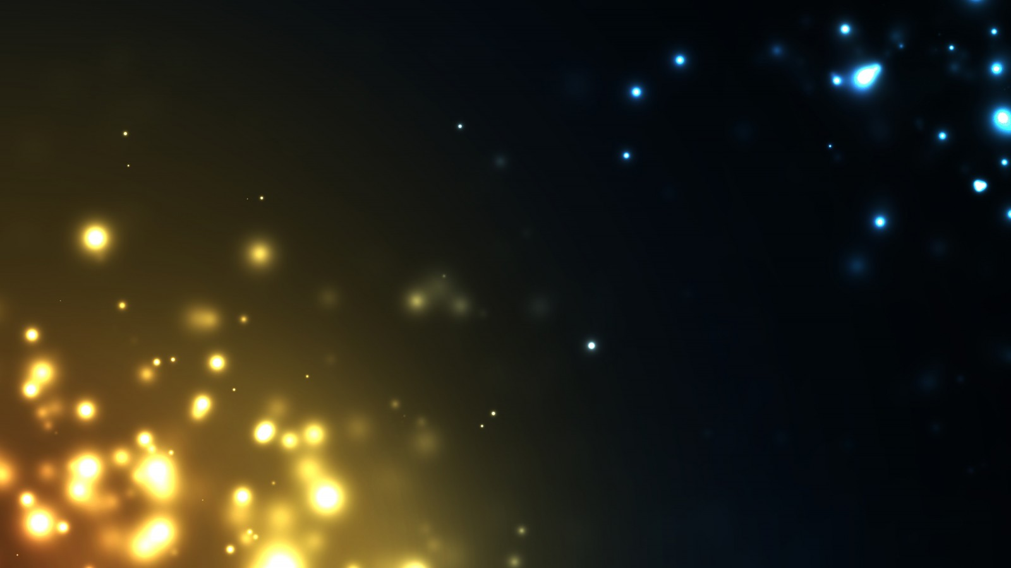
Particles System
Josep Casanovas Vidal
Iván Pérez Latorre

Slide 2
What is a particle?
Particles are graphic resources that have certain properties which are defined within a particle system.
…then what is a particle system?
“A particle system is a collection of many many minute particles that together represent a fuzzy object. Over a period of time, particles are generated into a system, move and change from within the system, and die from the system.”
—William Reeves, "Particle Systems—A Technique for Modeling a Class of Fuzzy Objects," ACM Transactions on Graphics 2:2 (April 1983), 92.

Slide 3
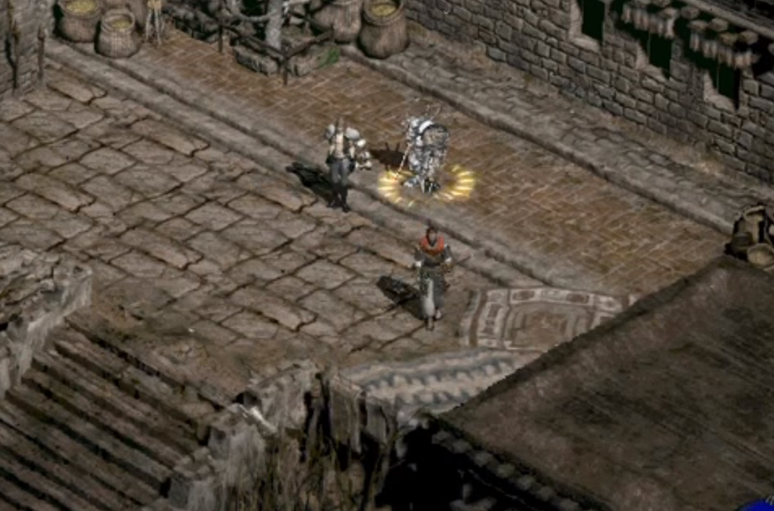
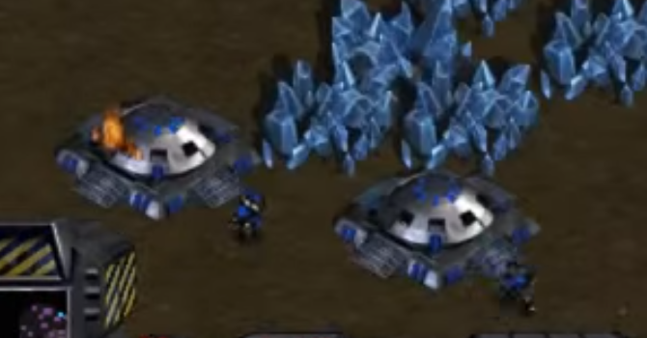
Example of particles
Diablo II
Starcraft

Slide 4
More examples
Unreal Engine 4 | Particles Showcase
https://www.youtube.com/watch?v=5WjwBPuL27I

Slide 5
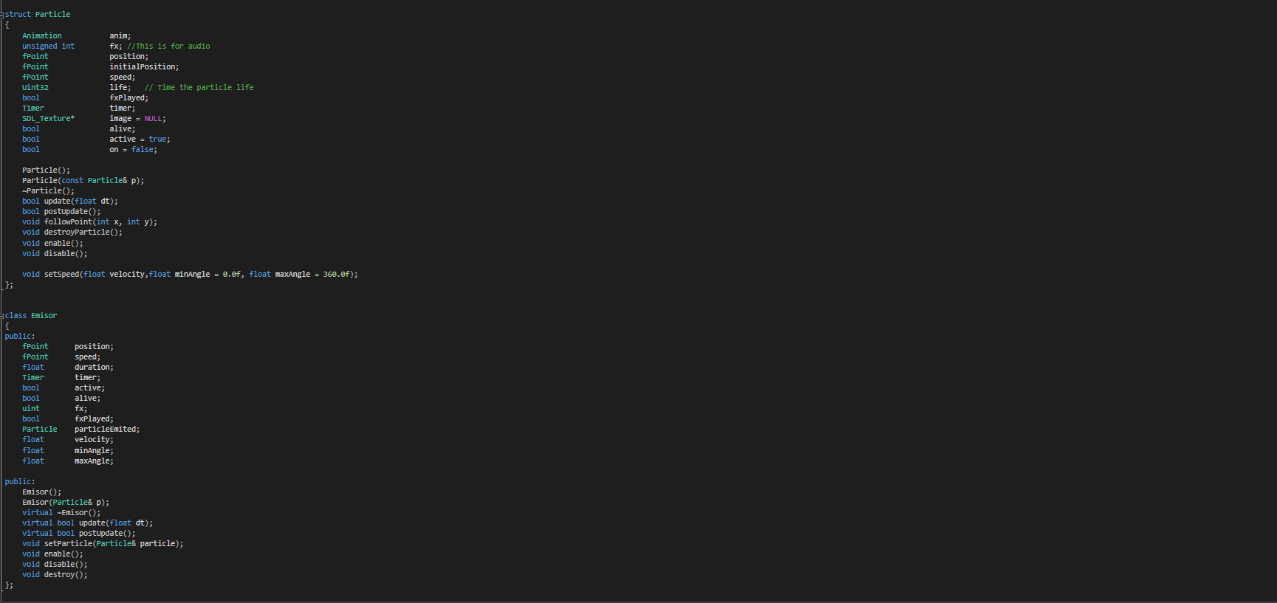
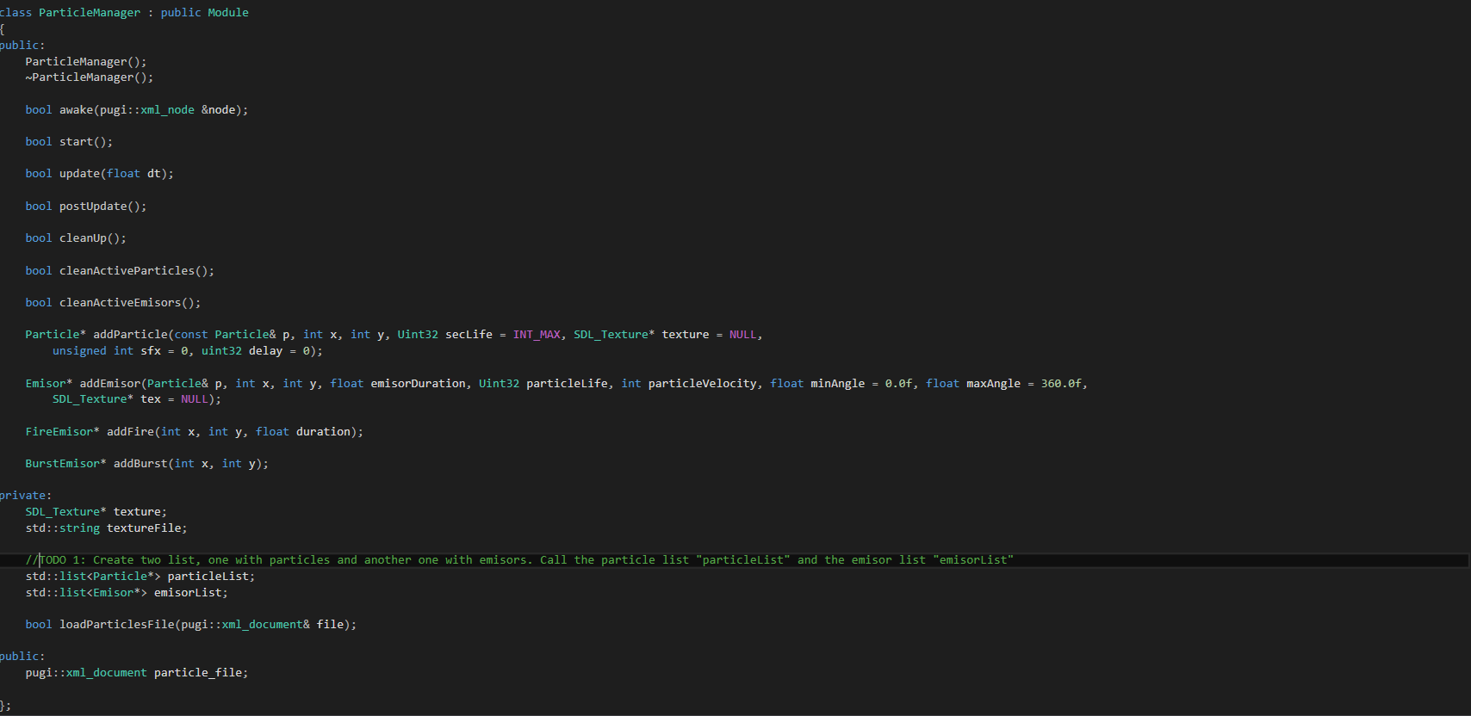
Code Structure

Slide 6
TODO 1
Create two list, one with particles and another one with emisors.
!!!! Call the particle list "particleList" and the emisor list "emisorList"

Slide 7
TODO 2
On update
Iterate the particles list
If update returns false, delete the particle
Iterate the emisor list
If update returns false , delete the emisor
On postUpdate
Iterate the particle list and call the postUpdate
Iterate the emisor list and call the postUpdate
On CleanUp
Iterate the particle list and clear, release the particle and clear the list
Iterate the emisor list and clear, release the particle and clear the list

Slide 8
TODO 2.1
Uncomment when TODO 2 is finished
This methods are used to clean all the active particles and emisors, if it’s needed.

Slide 9
TODO 3
Insert the particle in the particle list
Insert particles in the emisors list

Slide 10
TODO 4
If timer is bigger than the life of the particle OR particle isn't alive, then return false
Use timer.read() to compare the time with the life of the particle

Slide 11
TODO 5
Get the animation frame
Blit the image of the particle
Create a Particle* and call the addParticle method and fill the method with particleEmited
Set his speed with the setSpeed method.

Slide 12
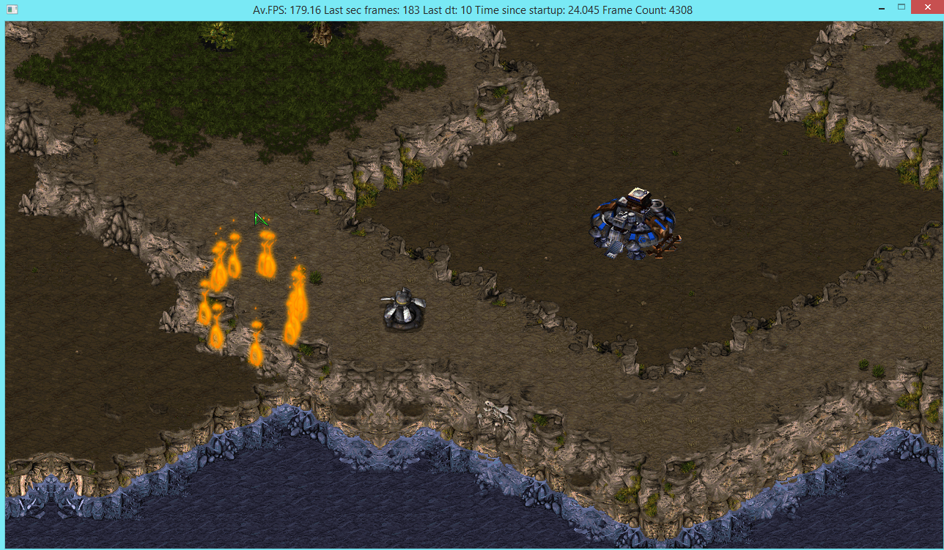
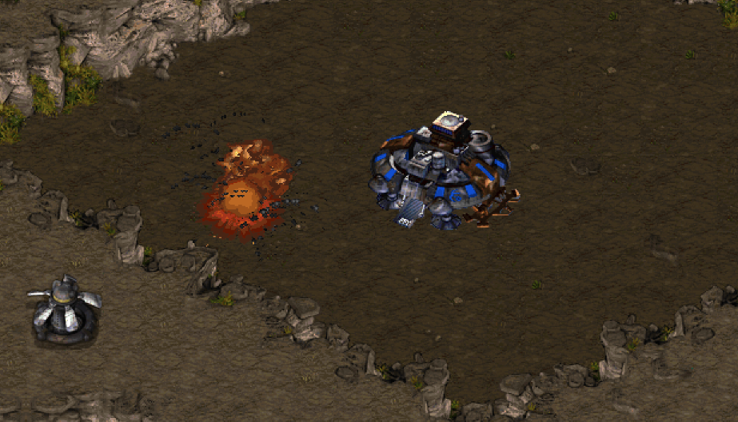
TODO 6
Uncomment and you can see the result

Slide 13
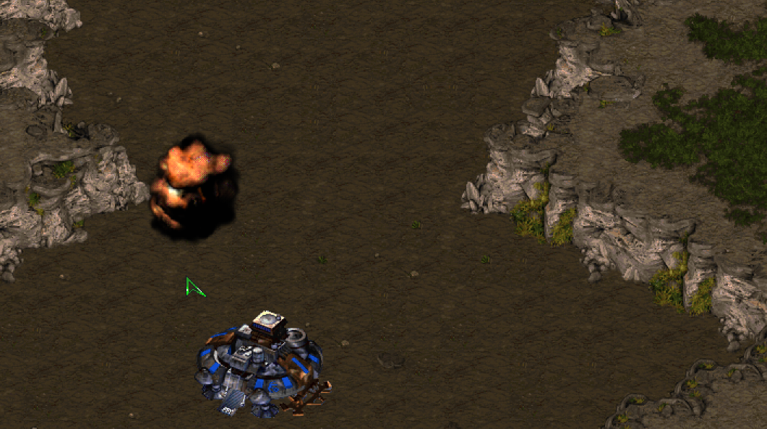
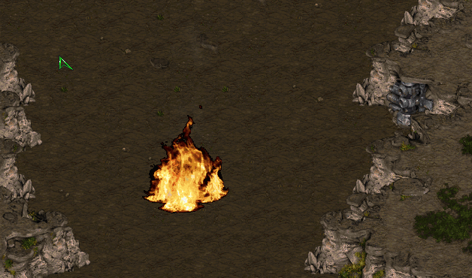
TODO 7
Uncomment and try to change values in particles.xml

Slide 14
What can be improved?
System of colliders for particles
More predefined emisors like Fire emisor or Burst
Change the alpha of the texture with the life time of the particles
Make particles with gravity
Everything else you could imagine!!

Slide 15
Useful resources
http://natureofcode.com/book/chapter-4-particle-systems/
http://lazyfoo.net/SDL_tutorials/lesson28/
http://buildnewgames.com/particle-systems/
https://es.khanacademy.org/computing/computer-programming/programming-natural-simulations/programming-particle-systems/a/intro-to-particle-systems

Slide 16
Thank You!

